Slide 1
LIBRARY MANAGEMENT SYSTEM
Project Progress Report
;
Submitted By
SHREEHARI N WADAWADAGI
REG.NO:-M215/06446/039
Under Guidance
Neema Motagi, Mca
B.V.V.Sangha’s
BASAVESHWARA INTERNATIONAL PUBLIC SCHOOL,
VIDYAGIRI, BAGALKOT

Slide 2
Introduction
Objective of project: To provide a Library Management System for college library, which would provide all library functions .
Rational: To improve library uses services and reduce paperwork.
Scope of Project:
To make the existing system more efficient.
To provide a user friendly environment where user can be serviced better.
Make functioning of library faster.
Provide a system where the library staff can catch defaulters and not let them escape.
To minimize the loss done to books.

Slide 3
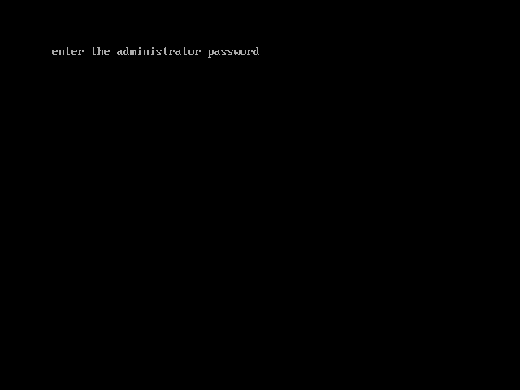

Slide 4


Slide 5
void main()
{
clrscr();
int choice;
char ans='y',password[5];
strcpy(password,getpass("\n\tenter the administrator password\n\t"));
if(strcmp(password,"hari")==0)
{
while(ans=='y'||ans=='Y')
{ clrscr();
cout<<"1.book deposit\n";
cout<<"2.book adoption\n";
cout<<"3.book search\n";
cout<<"4.book delete\n";
cout<<"5.book display\n";
cout<<"6.book return\n";
cout<<"7.book delete records\n";
cout<<"8.exit\n";
cin>>choice;

Slide 6
switch(choice)
{
case 1:clrscr();
book_deposit();
break;
case 2:clrscr();
book_adoption();
break;
case 3:clrscr();
book_search();
break;
case 4:clrscr();
book_delete();
break;
case 5:clrscr();
book_display();
break;
case 6:clrscr();
book_rturn();
break;
case 7: clrscr();
book_delete_records();
break;
case 8:exit(0);
break;
} default:cout<<"\ninvalid choice\n";

Slide 7
void book_deposit()
{
char s='y';
ofs.open("libraray_management.txt", ios::out|ios::binary|ios::app);
ofs.seekg(0,ios::end);
while(s=='y'|| s=='Y')
{
en.read();
en.stat();
cout<<"\n want to enter more records? (y/n)";
cin>>s;
ofs.write((char *)&en, sizeof(entry));
}
ofs.close();
getch();
}

Slide 8
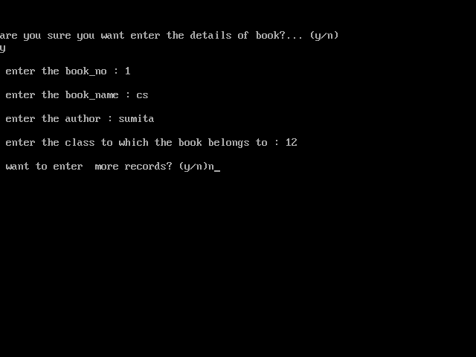

Slide 9
class entry
{
public:
char book_no[7]; int cls,stu_cls,stu_roll;
char book_name[25],author[15],status[5],stu_name[15];
public:
void read();
void stat();
void display(int ch);
char* getbook_no()
{
return(book_no);
}
char* getstatus()
{
return(status);
}
int getcls()
{
return(cls);
}
};

Slide 10
void entry::read()
{
int count;
char ans;
cout<<"are you sure you want enter the details of book?... (y/n)"<<endl;
cin>>ans;
if(ans=='y'||ans=='Y')
{
cout<<"\n enter the book_no : ";
cin>>book_no;
cout<<"\n enter the book_name : ";
cin>>book_name;
cout<<"\n enter the author : ";
cin>>author;
cout<<"\n enter the class to which the book belongs to : ";
cin>>cls;
}
}
void entry :: stat()
{
strcpy(status,"A");
strcpy(stu_name,"NAS");
stu_cls=0;
stu_roll=0;
}

Slide 11


Slide 12
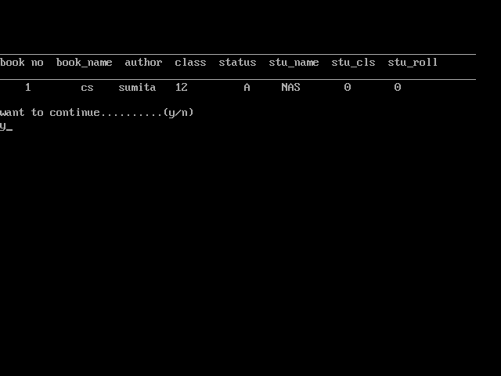

Slide 13
void entry :: display(int ch)
{
if(ch==1)
{
cout<<setw(5)<<book_no<<setw(10)<<book_name<<setw(10)<<author<<setw(5)<<cls<<setw(10)<<status<<setw(8)<<stu_name<<setw(8)<<stu_cls<<setw(8)<<stu_roll<<endl;
}
else
{
cout<<"\n____________________________________________________________________________\n";
cout<<"book no book_name author class status stu_name stu_cls stu_roll\n";
cout<<"____________________________________________________________________________\n";
}
}
entry en;
void book_display()
{
ofs.open("libraray_management.txt", ios::in|ios::binary);
ofs.seekg(0,ios::beg);
en.display(0);
while(ofs.read((char*)&en,sizeof(entry)))
{
en.display(1);}
ofs.close();getch();}

Slide 14


Slide 15
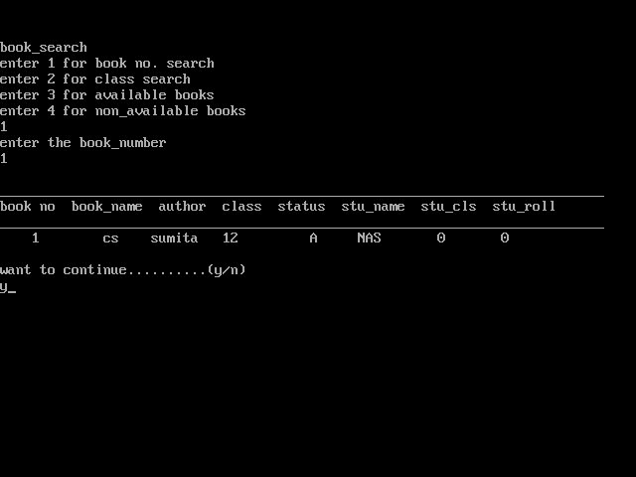

Slide 16
void book_search()
{
cout<<"book_search\n";
int ch;
cout<<"enter 1 for book no. search\n";
cout<<"enter 2 for class search\n";
cout<<"enter 3 for available books\n";
cout<<"enter 4 for non_available books\n";
cin>>ch;
switch(ch)
{
case 1:
char bn[7];
cout<<"enter the book_number\n";
cin>>bn;
book_no_search(bn);
break;
case 2:
int cl;cout<<"enter the class\n";
cin>>cl;break;
class_search(cl);
break;
case 3:
avail_or_non_able(1);
break;
case 4:
avail_or_non_able(0);
break;
default: cout<<"invalid entry";
}
}

Slide 17
void book_no_search(char bn[])
{
int temp=1;
ofs.open("libraray_management.txt", ios::in|ios::binary);
en.display(0);
while(ofs.read((char *)&en,sizeof(entry)))
{
if(strcmpi(en.getbook_no(),bn)==0)
{
en.display(1);
temp=0;
}
}
if(temp==1)
{
cout<<"NOT FOUND\n";
}
ofs.close();
}

Slide 18
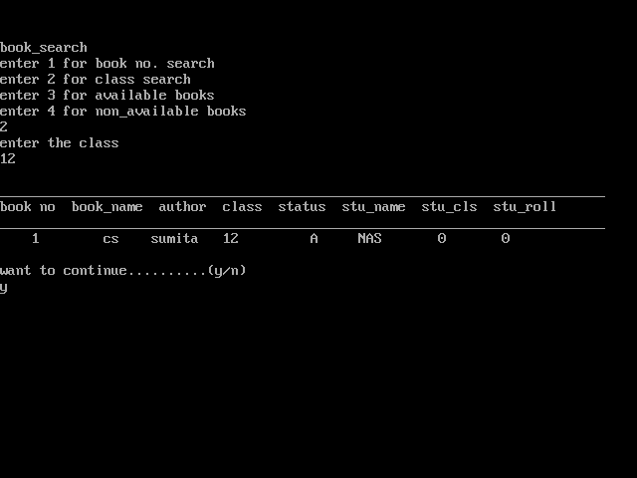

Slide 19
void class_search(int cl)
{
int temp=1;
ofs.open("libraray_management.txt", ios::in|ios::binary);
en.display(0);
while(ofs.read((char*)&en,sizeof(en)))
{
if(en.getcls()==cl)
{
en.display(1);
temp=0;
}
}
if(temp==1)
{
cout<<"NOT FOUND\n";
}
ofs.close();
}

Slide 20
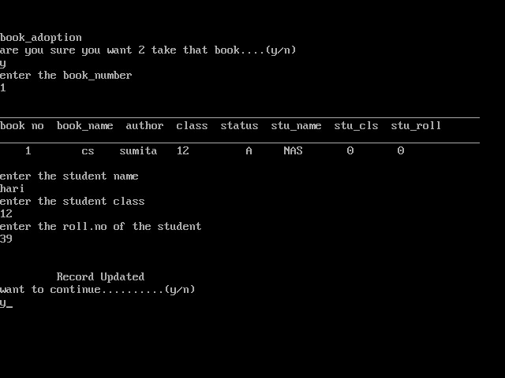

Slide 21
void book_adoption()
{
int tmp=1;
cout<<"book_adoption\n";
char f;
cout<<"are you sure you want 2 take that book....(y/n)\n";
cin>>f;
if(f=='y' || f=='Y')
{ char bn[7];cout<<"enter the book_number\n";cin>>bn;
book_no_search(bn);
ofs.open("libraray_management.txt", ios::in|ios::binary|ios::out);
ofs.seekg(0,ios::beg);
while(!ofs.eof())
{
long pos=ofs.tellg();
ofs.read((char*)&en,sizeof(entry));
if((strcmpi(en.getbook_no(),bn)==0) &&(strcmpi(en.getstatus(),"A")==0))
{ modifystu(0);
tmp=0;
ofs.seekg(pos);
ofs.write((char*)&en,sizeof(entry));
cout<<"\n\n\t Record Updated";
break;
}}
if(tmp==1)
{
cout<<"NOT AVAILABLE"<<endl;
}}ofs.close();getch();}

Slide 22
void modifystu(int n)
{
if(n==0)
{
strcpy(en.status,"NA");
cout<<"\nenter the student name\n";
cin>>en.stu_name;
cout<<"enter the student class\n";
cin>>en.stu_cls;
cout<<"enter the roll.no of the student\n";
cin>>en.stu_roll;
}
else
{
strcpy(en.status,"A");
strcpy(en.stu_name,"NAS");
en.stu_cls=0;
en.stu_roll=0;
}
getch();
}

Slide 23
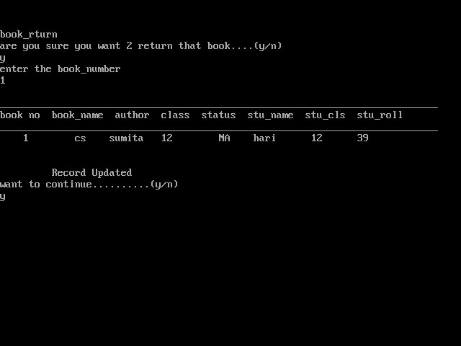

Slide 24
void book_rturn()
{
int tmp=1;
cout<<"book_rturn\n";
char f;
cout<<"are you sure you want 2 return that book....(y/n)\n";
cin>>f;
if(f=='y' || f=='Y')
{ char bn[7];
cout<<"enter the book_number\n";
cin>>bn;
book_no_search(bn);
ofs.open("libraray_management.txt", ios::in|ios::binary|ios::out);
ofs.seekg(0,ios::beg);
while(!ofs.eof())
{
long pos=ofs.tellg();
ofs.read((char*)&en,sizeof(entry));
if((strcmpi(en.getbook_no(),bn)==0) && (strcmpi(en.getstatus(),"NA")==0))
{ modifystu(1);
tmp=0;
ofs.seekg(pos);
ofs.write((char*)&en,sizeof(entry));
cout<<"\n\n\t Record Updated";
break;
}
}
if(tmp==1)
{cout<<"NOT FOUND"<<endl;}}ofs.close();
getch();
}

Slide 25
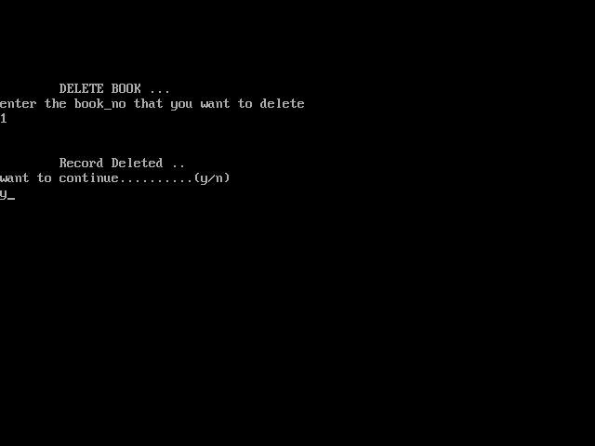

Slide 26
void book_delete()
{
char bn[7];int tmp=1;
clrscr();
cout<<"\n\n\n\tDELETE BOOK ...";
cout<<"\nenter the book_no that you want to delete\n";
cin>>bn;
ofs.open("libraray_management.txt",ios::in|ios::out|ios::binary);
fstream fp2,fp1;
fp2.open("temp.txt",ios::out|ios::binary);
fp1.open("delete_records.txt",ios::out|ios::binary|ios::app);
ofs.seekg(0,ios::beg);
while(ofs.read((char*)&en,sizeof(entry)))
{ if((strcmpi(en.getbook_no(),bn)==0) && (strcmpi(en.getstatus(),"A")==0))
{ fp1.seekg(0,ios::end);
fp1.write((char*)&en,sizeof(entry));
tmp=0;}
else
{ fp2.write((char*)&en,sizeof(entry));} }
if(tmp==1)
{cout<<"RCORD NOT FOUND\n";}
else
{cout<<"\n\n\tRecord Deleted ..";}
fp2.close();ofs.close();fp1.close();
remove("libraray_management.txt");
rename("temp.txt","libraray_management.txt");
getch();
}

Slide 27
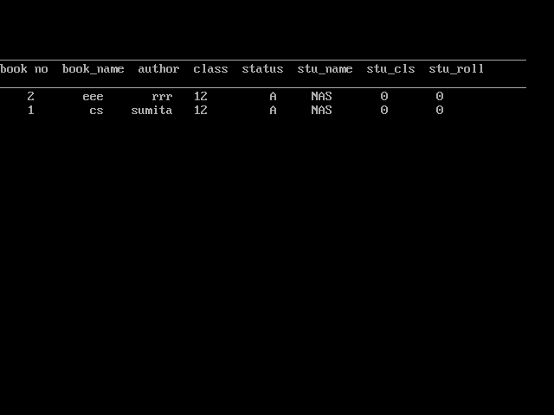

Slide 28
void book_delete_records()
{
ofs.open("delete_records.txt", ios::in|ios::binary);
ofs.seekg(0,ios::beg);
en.display(0);
while(ofs.read((char*)&en,sizeof(entry)))
{
en.display(1);
}
ofs.close();
getch();
}

Slide 29
QURIES ?

Slide 30
THANK YOU

